Slide 1
Brutus Bulkhead
Brief History and Work done by Bulkhead Committee
March 7, 2020

Slide 2
Your Brutus Bulkhead Committee
Dennis Stettler (chair)
Fred Allie
Steve Solatka
Ronald Moe
Ken Harvey
Larry Ringstad
Ron Louviere

Slide 3
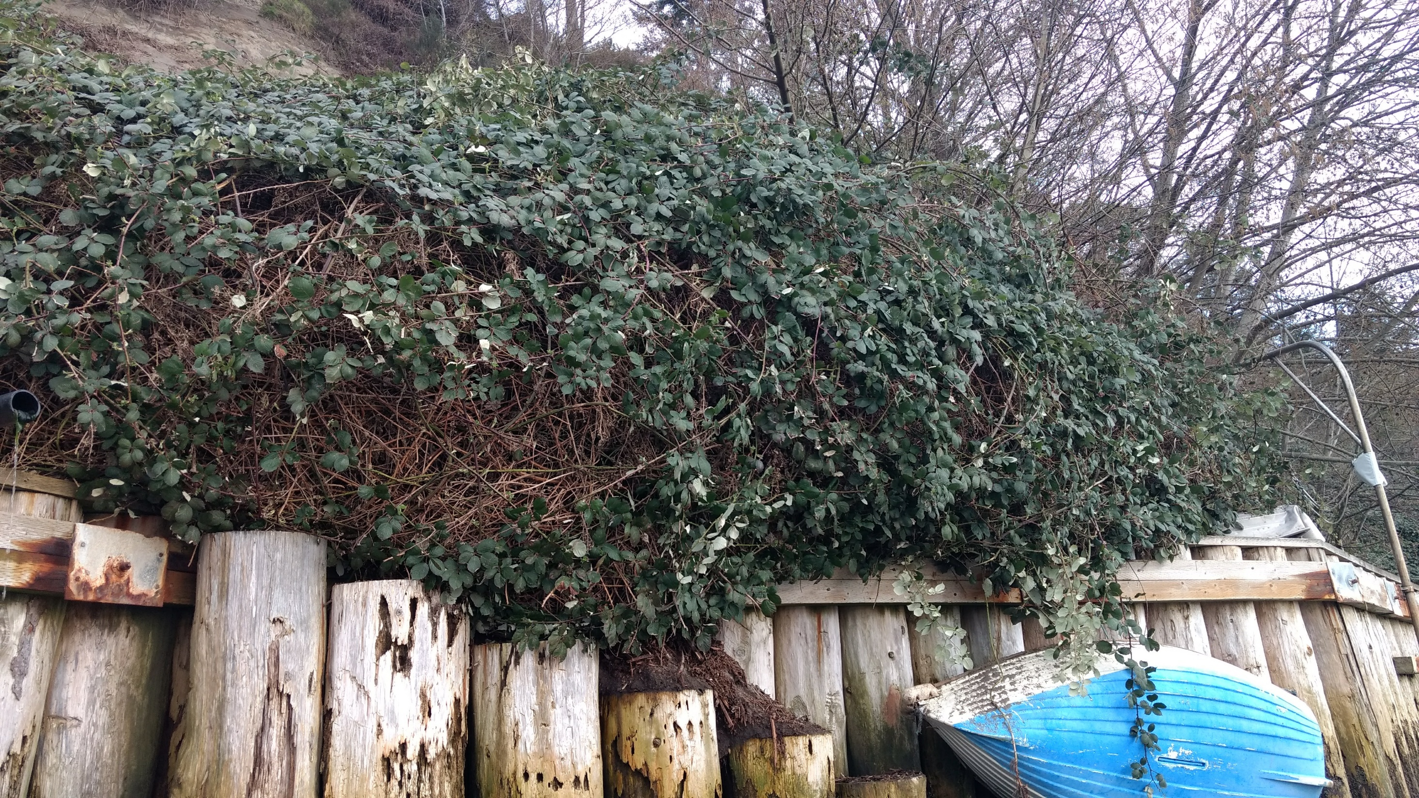
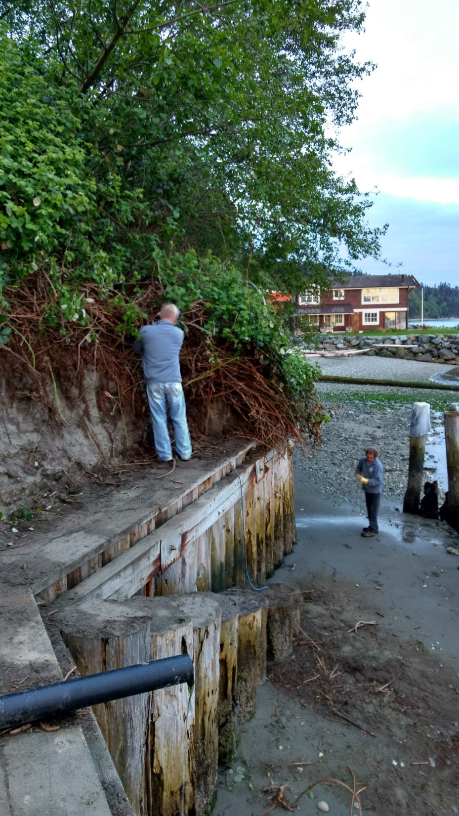
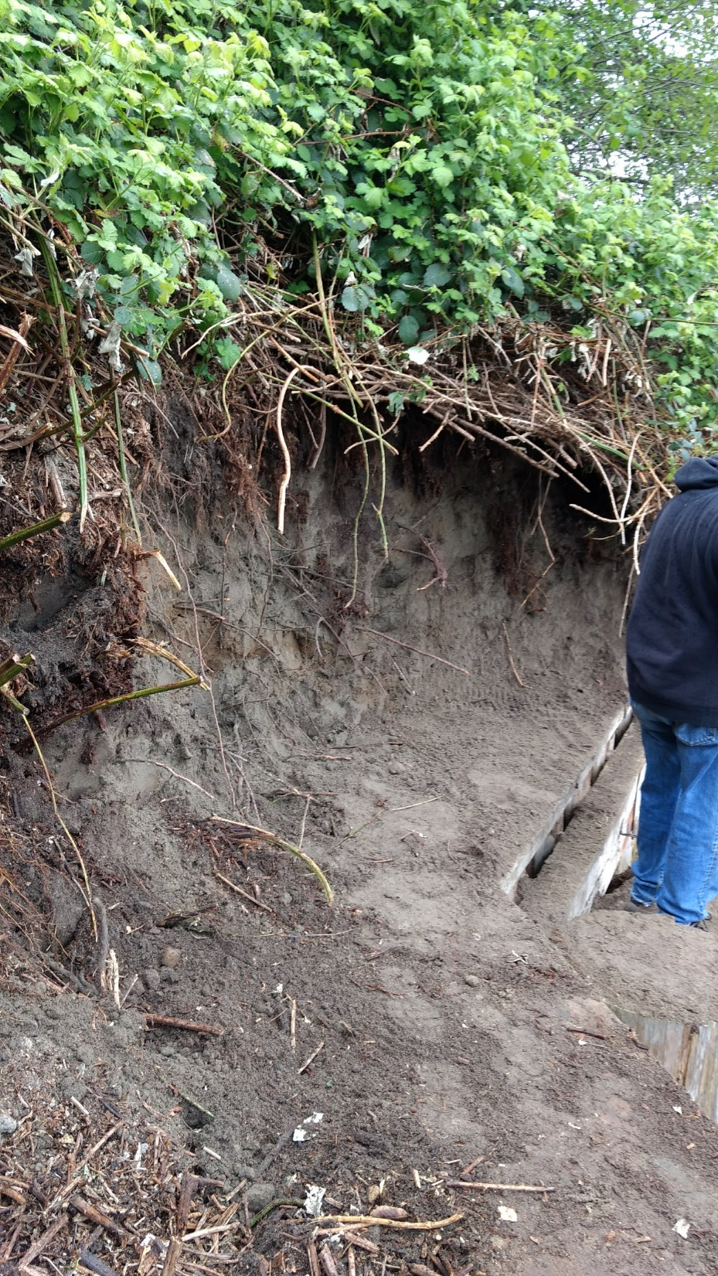
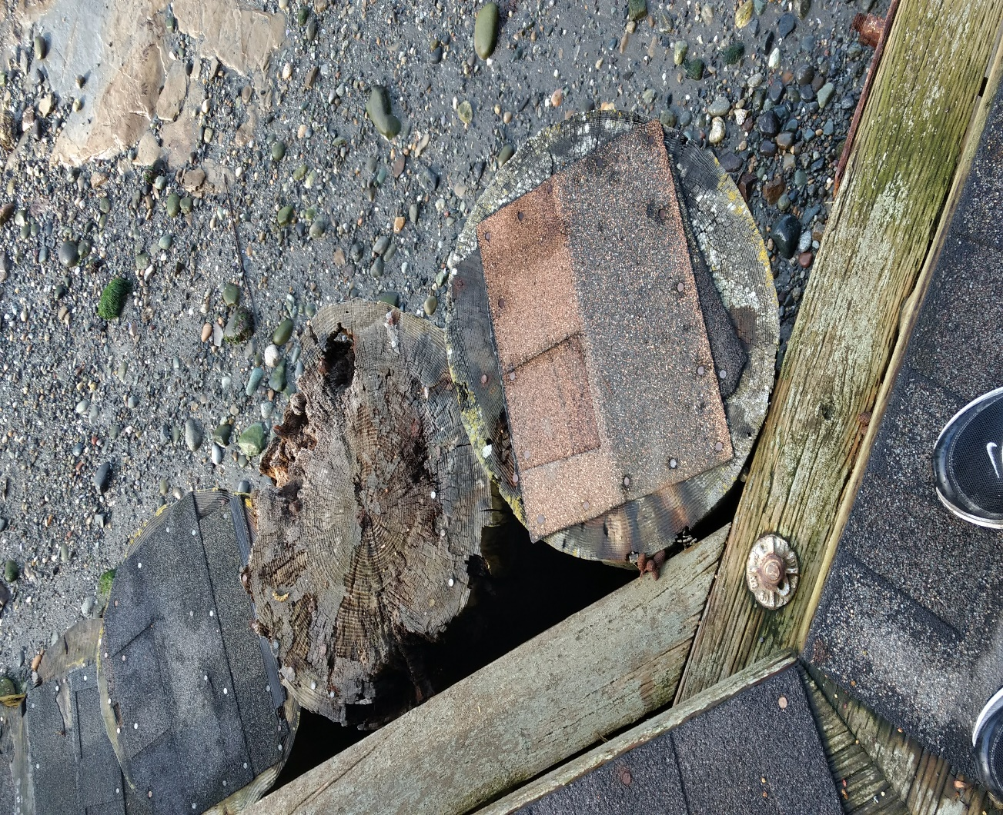

Slide 4
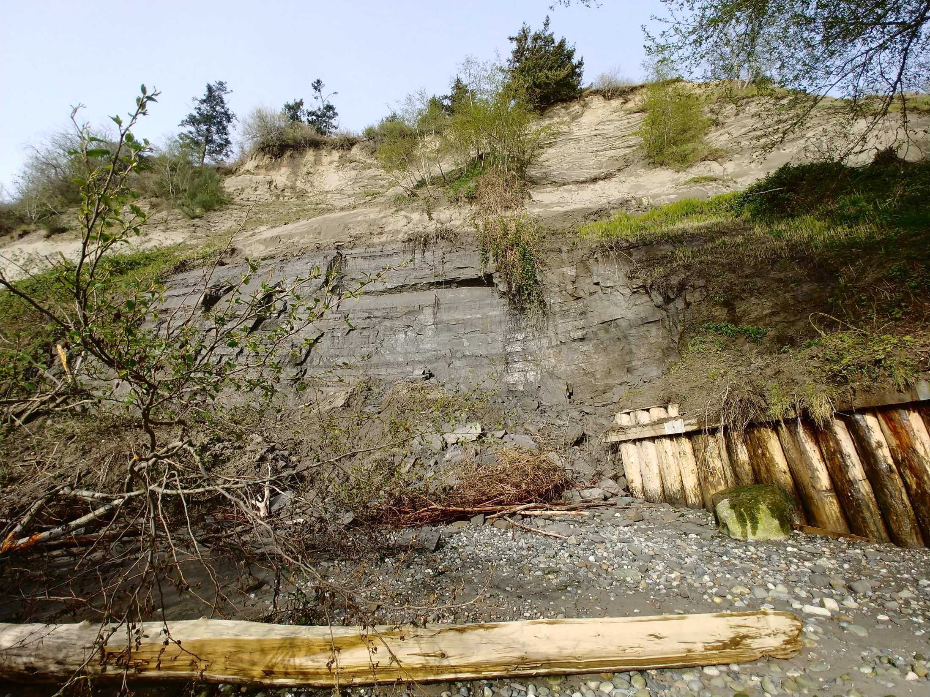
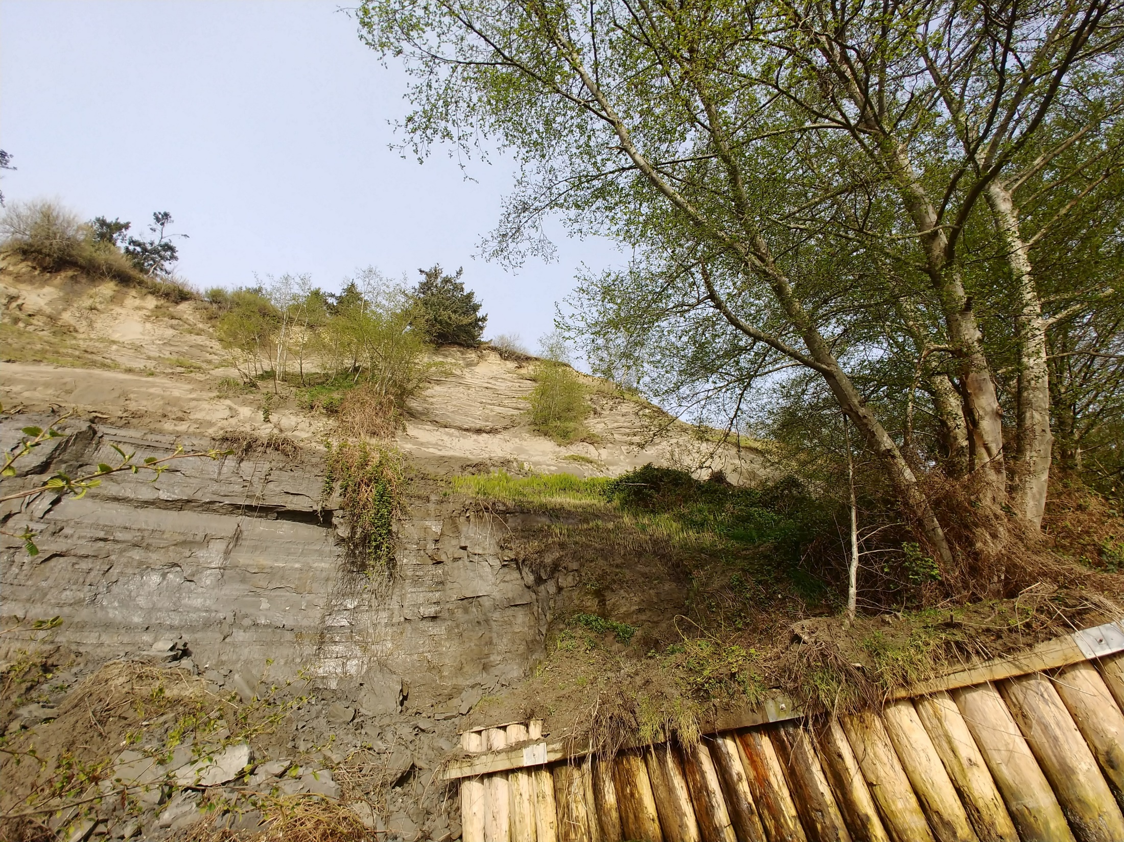
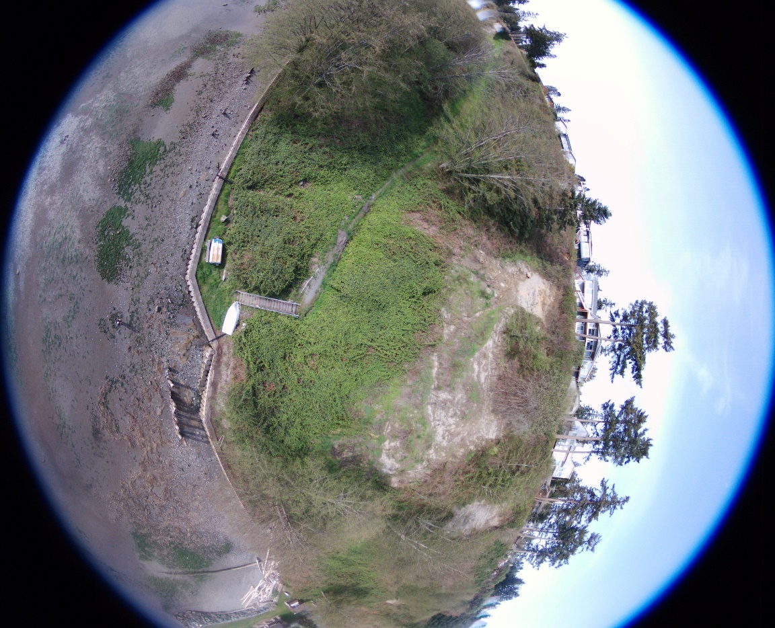

Slide 5
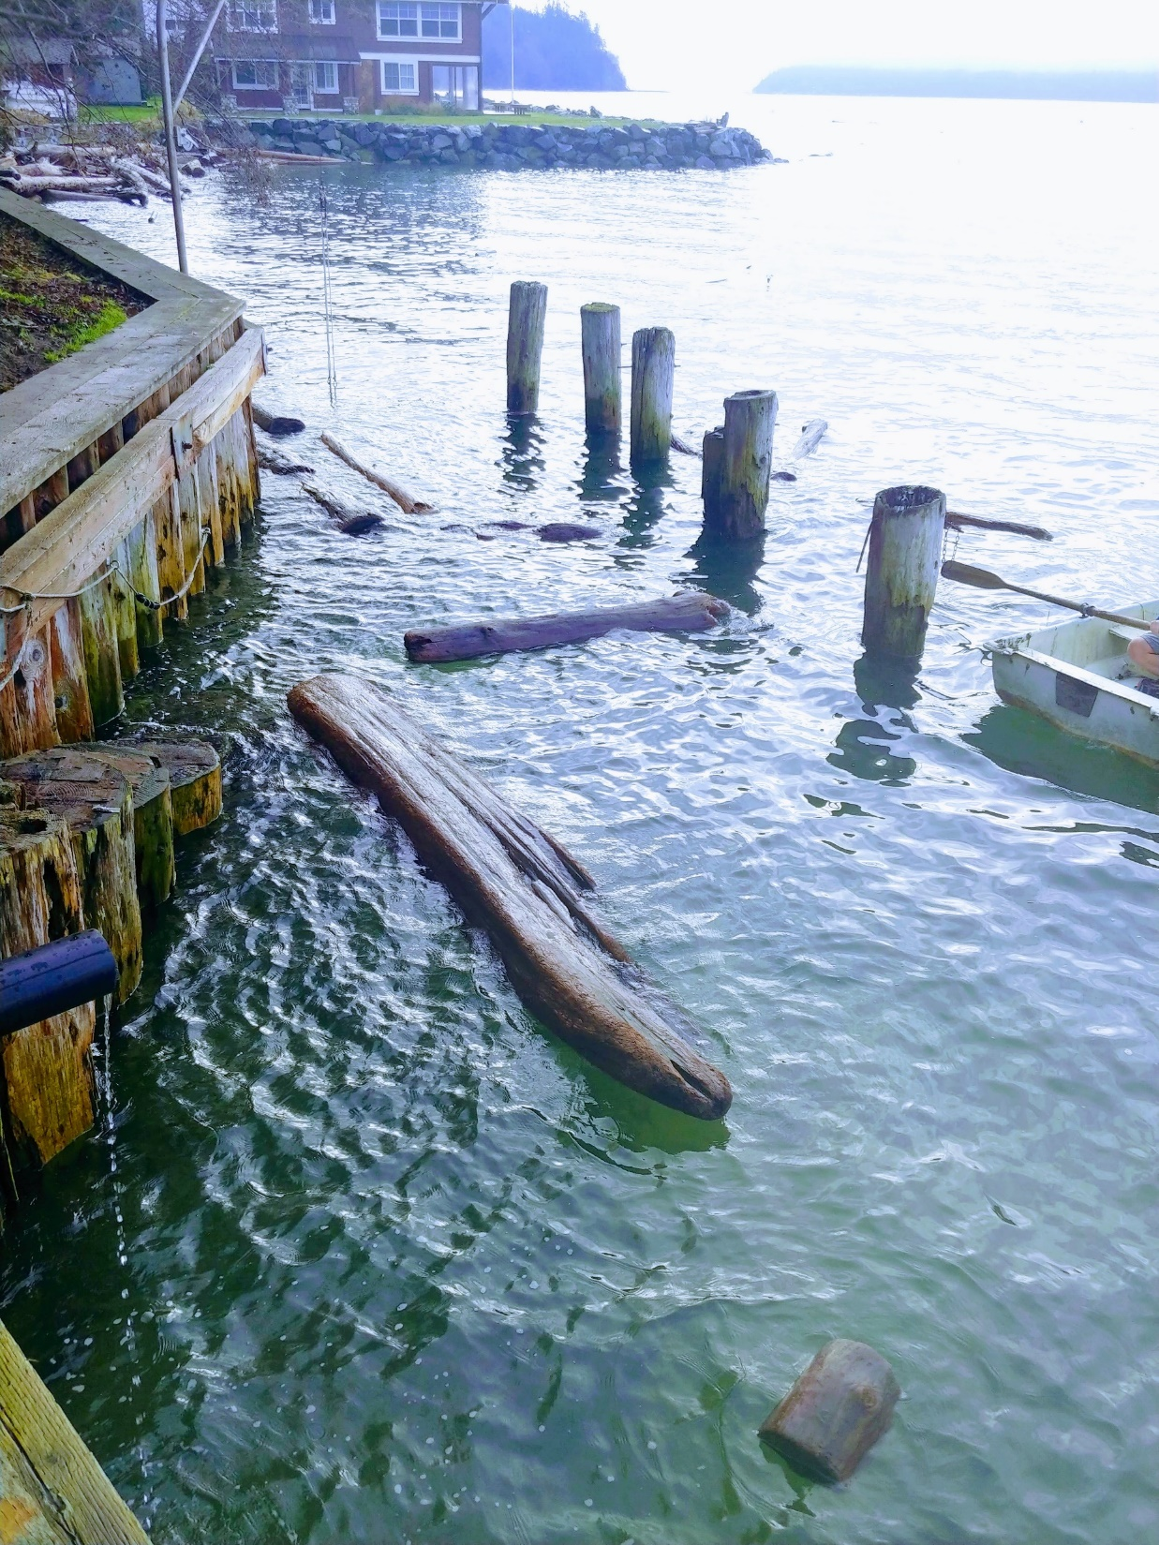

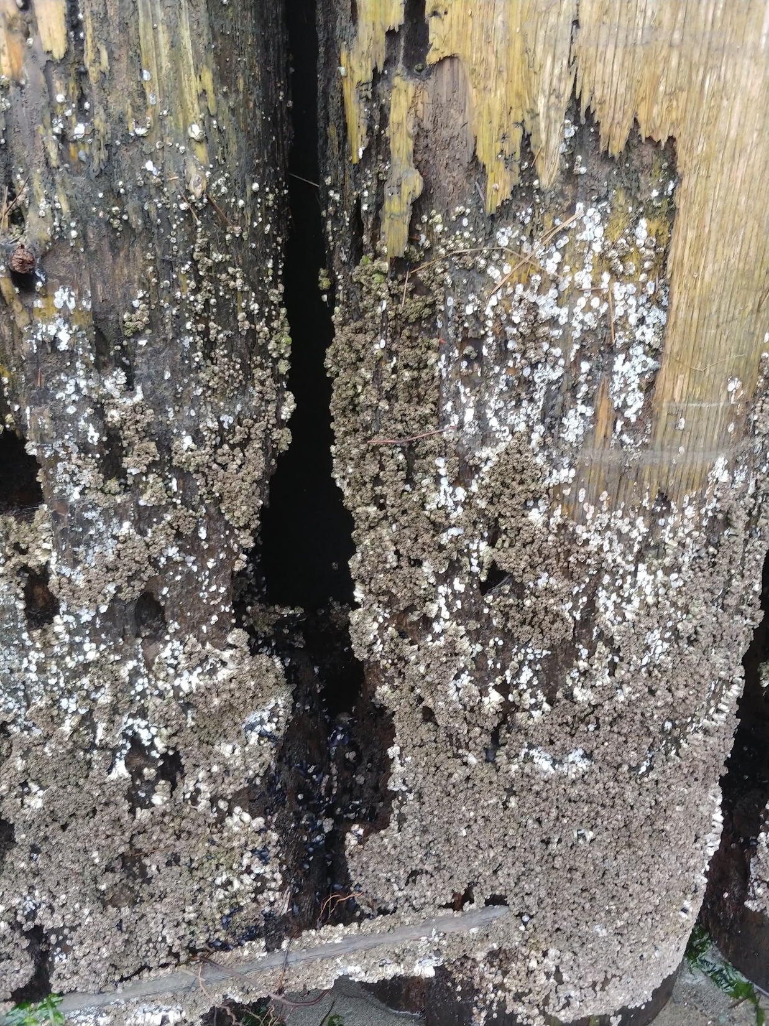

Slide 6
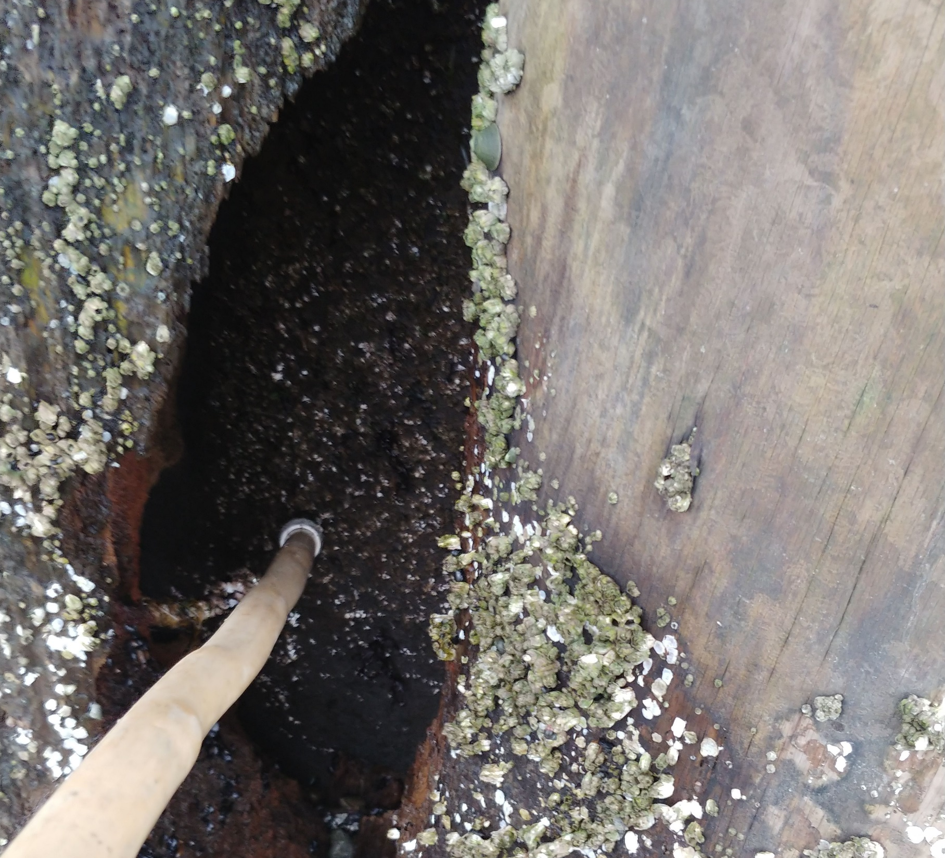
Badly Deteriorated Timber Piles
Many areas are open to felt only providing protection.

Slide 7
Agenda
Bulkhead Obligations
History of Brutus Bulkheads
Present Condition of Brutus Bulkhead
  Comparison of past bulkheads
Benefits Provided by Bulkhead
Information from Bulkhead Contractors and Government Agencies
Different Bulkhead Types with pros, cons, permit possibilities and rough costs
Next steps

Slide 8
What the CCR’s and Bylaws say about bulkhead and common properties
4.1 Operation
The Association shall operate and maintain, at its cost, in neat and good order, and for the use and benefit of the owners of the property in the development, all land and/or facilities designated
4.4.2 Common Property Rights
Subject to the provisions of these covenants, every member of the Association shall have a right of easement and enjoyment in and to the common properties. Such easement shall be appurtenant to and shall pass with the title to every lot or living unit and upon recordation of a contract of sale of any lot or living unit.

Slide 9
5.0 Maintenance Assessments
Annual and Special Assessments levied by the Association shall be exclusively for the purpose of promoting the health, safety, enjoyment and welfare of the residents in the properties, and in particular for the improvement and maintenance of property, services, and facilities devoted to that purpose and related to the use and enjoyment of the properties within the Plat of Brutus. Without limiting the generality of the foregoing, assessments may be used for the acquisition, maintenance and operation of a water system and common properties which are inclusive of and not limited to the beach trail and bulkhead.
5.1 Subject Property
All building sites are subject to Annual and Special Maintenance Assessments to cover the costs of operation, maintenance, replacement and extension of the water system and common areas. Such charges and assessments shall be levied against each membership property and shall be the personal liability of the members owning and/or possessing such property. Out of Plat water users and beach access users will be assessed dues as defined in paragraphs 8.5, 8.6 & 8.7 of the Bylaws.

Slide 10
History of Brutus Bulkhead(s)
First Brutus Bulkhead was installed by developer in early 1980’s to protect the shoreline as an integral part of the original development
  It was damaged and lost in a winter storm
  Some of original poles are still there about 15+ feet from present bulkhead
Second Bulkhead installed in mid 1980’s
  Lost about 15 feet of land
2001 Decisions
  Approval to obtain Bulkhead Replacement Permit for 300’
  Temporary Repairs and replace south 44 feet in corner below stairwell

Slide 11
Repairs by Jesse in 2001-2002
2000: added steel cabling for additional strength and boards to close some holes where poles were missing (could possibly need again if not moving forward in timely manner)
2001 Obtained County Permit in October
2002 Obtained Fisheries Permit in February
2002 Mid March added some new backing cloth in places; back filled several hundred yards of fill into holes above bulkhead; placed some logs in south corner where 44 feet were missing
44 foot gap replacement work scheduled between Sept – Nov 2002

Slide 12
Bulkhead Bid Statement of Work 2004
Jesse bid to replace bulkhead in 2002; actual construction in 2004.
  New poles, horizontal beams & steal connector plates, new vertical closure boards, felt backing cloth, deadmen every 10 feet, backfill behind bulkhead, new capping planks, build new beach stairs near the stairwell.
  More recent work on bulkhead was completed around 2009-2010 for addition/repair of south end. This included addition of bulkhead near Summerland.

Slide 13
Investment Benefits
Bulkhead should last 15-50+ years – depending on materials used
Trail access to be beach is secured and protected
Homes on the water side of Brutus are protected from accelerated bluff erosion
Reduces the dangerous condition and liability of bulkhead that has previously existed
Property values are protected
  Estimated $40,000 to $50,000 or more per home for value of water access

Slide 14
The Bulkhead Adds Value
From: Jim Ayers <jimayers@windermere.com>
Sent: Wednesday, August 14, 2019 1:04 PM
To: ronaldmoe2@comcast.net
Subject: Brutus trail and beach access
Ron,
After discussion with several Windermere Brokers, we have determined that, at a minimum, the Brutus trail and beach access adds $40,000 to $50,000 in value to the homes in the association. The quality of the access and beach is seldom matched anywhere on Camano Island and provides a strong selling point for potential buyers.
Please let me know if you’d like additional information.
Thanks,
Jim
Jim Ayers
Broker | REALTOR®

Slide 15
General Bulkhead Condition
Vertical poles severely deteriorated and rotten (present and past same)
Erosion of the beach area at bottom of bulkhead continues yearly that could lead to instability of bulkhead.
Backing cloth previously failed, and presently there are many gaps in wood showing backing cloth. We were told that when failure takes place, there will be significant erosion behind bulkhead.
Beach pole stair is damaged and dangerous.
Bulkhead was about 17-19 years old and required significant maintenance and repairs prior to replacement in about 2004 …We are presently approaching about 16 years with existing bulkhead.

Slide 16
The Bulkhead Committee has Learned a Lot
The Bulkhead Committee identified and solicited interest from 9 potential bulkhead contractors and 5 contractors visited us and provided feedback and costs based on their experience.
Members of the Committee have talked with the Area Biologist from the Washington State Department of Fish and Wildlife, Shoreline Permitting Specialists from Island County, and engineers and permitting specialists in private practice.
Members of the committee have visited other sites to look at examples of shoreline bulkheads.
In talking with Island County shoreline specialists, they identified the Northwest Straits Foundation who had state and federal grant money to evaluate shoreline conditions, who hired Coastal Geologic Services to evaluate our shoreline.

Slide 17
Coastal Geologic Services Study-2019
Permitting agencies do not like bulkheads and would much rather see “soft shore” approach.
Northwest Straits Foundation Grant paid for feasibility study to change to soft shore at no cost to Brutus.
The report provides outline of existing site conditions and proposed recommendations.
Evaluated the feasibility of full or partial bulkhead removal and replacement.
Concluded that coastal configuration and wave environment would make soft shore infeasible.
Brutus added contract for $500 to extend study to include comparison of bulkhead alternatives

Slide 18
Coastal Geologic Services Study-2019
Conclusions and Recommendations
The slides along the bluff all appear to be shallow surficial slides, with loss of only several feet of weathered soils with each slide.
No evidence of large of deep‐seated slides was found in the area during the site visit.
The decision regarding potential wall removal revolves around the need to preserve the trail in the next few decades, as well as the repeated costs of rebuilding the pile wall.

Slide 19
Coastal Geologic Services Study-2019
Full Bulkhead Removal Alternative
With full bulkhead removal, erosion of the shoreline would accelerate and progress back towards the bluff. Portions of the trail would likely fail within 5 years or so. If maintaining the trail and beach access is important, a simple full wall removal would not be feasible.
Upper bluff recession in the first 10‐20 years following bulkhead removal is estimated at up to approximately 10 FT and would continue over time. (This means that the top of slope would move back towards the homes at the top of the bluff by this average amount – some could be more / some could be less).
Partial Bulkhead Removal Alternative
It would expose the lower bluff and the south end to some additional erosion landward of some Brutus properties.

Slide 20
Coastal Geologic Services Study-2019
The objective of the Coastal Geologic Services Study conducted for the Northwest Straits Foundation was to evaluate the feasibility of removing all or a portion of the bulkhead and allowing the shoreline to revert to a more natural condition.
The report demonstrated that without the bulkhead in place, shoreline erosion would occur that would allow the shoreline to erode into the bluff. As the toe of the bluff is eroded, landslides would occur that would move the top of the bluff closer to the bluff-top homes over a period of time.
The eventual result would be loss of the trail and beach access at Brutus and increased susceptibility of the homes at the top of the bluff to landslides.
The Bulkhead Committee and the BMA Board concur that full or partial removal of the bulkhead is not acceptable given the probable eventual outcome.

Slide 21
Bulkhead Types Pros/Cons (from Coastal Geologic Services)
Armor Type | Pros | Cons | Permit Feasibility | Cost $ Low to high
Wood pile bulkhead | In-kind replacement (better for permitting) relatively low profile | Lifespan shorter (-20 yrs) | Moderate | $$$
Steel sheet pile wall | Durable and low profile. Lifespan longer (40-60 yrs) | Specialized equipment needed | Low to mod | $$$$$
Vinyl sheet pile wall | Low profile | Not as durable with considerable log impact. May be difficult to drive deep enough | Low to mod | $$$
Rockery Wall X | Less equipment needed | Very skilled operator required. Periodic maintenance. Height is problematic. | Low to mod | $$$
Rock revetment X | Simple construction. Easy repair | Large rock volume. Very wide footprint. Some settling | Low without significant crest pullback | $$$
Concrete wall | High strength and long lasting if designed and built well | Durable over time, however, can crack w/log impact. Concrete delivery required. Expensive | Low to mod | $$$$
Concrete block wall X | Lower cost using pre-fab blocks | Low durability, too much wave energy and height for this approach. Not recommended | low | $$-$$$

Slide 22
Preliminary Cost Ranges
Temporary Patch Holes with Wood (Bandaid)
Wood Bulkhead (about 15 year life)
Vinyl Sheet Pile (about 50 year life)
Steel Sheet Pile (about 50 year life)
About $150,000
About $400,000-500,000
About $500,000-$600,000
About $600,000-$800,000

Slide 23
What have we learned?
Replacing a bulkhead is not an easy process.
The permitting process for any shoreline project is much more complicated than it has EVER been.
Bulkheads have become very costly. The same bulkhead contractor that constructed our existing wood bulkhead in about 2004 has given us a price to construct a new wood bulkhead exactly like our existing bulkhead for 8 times the cost he charged for the existing bulkhead.
Replacing our timber bulkhead with another timber bulkhead is both expensive and only has a limited life of maybe 15 years or so. We do not know how much more expensive it will be 15 years from now and whether we could even obtain another permit 15 years from now.
The Bulkhead Committee and Board have a strong preference for a bulkhead type that has strong durability and a long design life (let’s not do this again for a long time!).

Slide 24
Remaining Questions
Permitting Requirements – What will the permitting agencies require for this project?
No permitting work has been done to date and that process typically takes 12-18 months.
What are the engineering parameters required for the various alternatives? Do vinyl walls have sufficient strength and durability for our bulkhead height and wave environment?
No engineering work has been done. At least preliminary engineering will be required to start the permitting process and final engineering plans will be required to obtain permits from Island County.
Obtaining viable prices from contractors will require that the design and permitting requirements be defined. Any prices at this time would be subject to revision once the design and permitting requirements are defined.

Slide 25
We need to hire consultants to advance the permitting and design of the bulkhead to resolve these questions and move the project forward
We will need:
A shoreline permitting specialist
A structural engineer with experience in bulkhead design and construction
A land surveyor to provide a property survey (required by Island County)
A geotechnical engineer to establish soil design parameters for use by the structural Engineer
The Bulkhead Committee Chair has talked with a number of consultants and has identified Davido Consulting Group. The have very good experience and are currently working on the design and permitting of 4 Puget Sound shoreline bulkheads for homeowners associations.
Estimated Cost: About $70,000

Slide 26
A Very Generous Offer from our Neighbors
Jason and Marjorie Zander have indicated a willingness to make a substantial contribution to the cost of the bulkhead replacement with the following objectives:
Maintain stability and integrity of the bluff
Create a safer solution for getting down to the beach (upgraded steps, safety rails, etc. to help avoid accidents and make it more accessible to everyone)
Help offset the cost for our neighbors
Optimize for longevity of the solution (avoid having to do this every 15 years).
Details to be determined

Slide 27
Financing Options
BMA Treasurer called two local banks last summer about loans to help finance the new bulkhead and received positive initial, non-biding responses from both:
  Washington Federal – 65% loan-to-value, 5+ year amortization, interest rate not specified
  Coastal Community – 65-70% LTV, 7 year amortization, 4.5 – 6.5% interest rate
Homeowners collectively would need to pay ~35% of total value as down payment – some could pay 100% down, others 0% down, as long as average was 35%
Homeowners who don’t pay 100% down would make monthly payments to BMA to pay off their share of the loan – approximately $165/month per $10,000 “borrowed” (6 years, 5.5% interest)

Slide 28
Next Steps
The Board is mindful of the significant cost of this project, but also recognizes the need, benefits, and required contractual obligation to maintain the bulkhead and common areas.
Make decision to move forward with gaining more information on type of bulkhead replacement, cost and financing
  Vote in the near future to authorize the Board to use Brutus funding to hire consultants for engineering, permits, and survey.
  Obtain additional information on funding assistance from financial institutions or other sources
    Intent is to minimize impact to Brutus members
  Report final recommendation to Brutus association for bulkhead type that is identified by engineering that is best suited for shoreline site conditions.
  Include Sweeney in bulkhead process to meet contracted obligations.
  Obtain Final Authorization from Brutus Maintenance Association for bulkhead replacement special assessment in a future vote once design, permitting, and construction cost are determined and funding approaches are better defined.

